Slide 1

RETAIL DATA ANALYSIS
[STUDENT NAME]

Slide 2
INTRODUCTION
Trend analysis
Customer insights
timing
RETAIL INDUSTRY IS BOOMING WITH THE HELP OF THE BIG DATA ANLYTICS BY PREDICTING THE BUYING BEHAVIOUR.
THE PROJECT TRIES TO FIND OUT DIFFERENT INSIGHTS FROM THE RETAILDEMO DATA AVILABLE IN SAS VIYA PLATFORM.
THE INSIGHTS WILL BE HELPFUL IN IMPROVING SALES AS WELL AS PROMOTIONS.

Slide 3
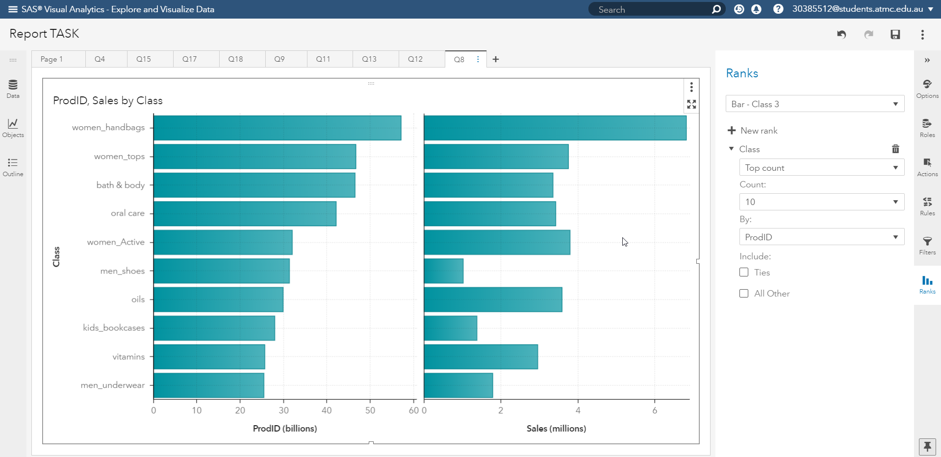
Insights
The plot at the side shows the top 10 products in terms of sales.
from the above it can be stated that highest sales are recorded for woman handbags.
Lowest number of sales are recorded for men underwear.

Slide 4
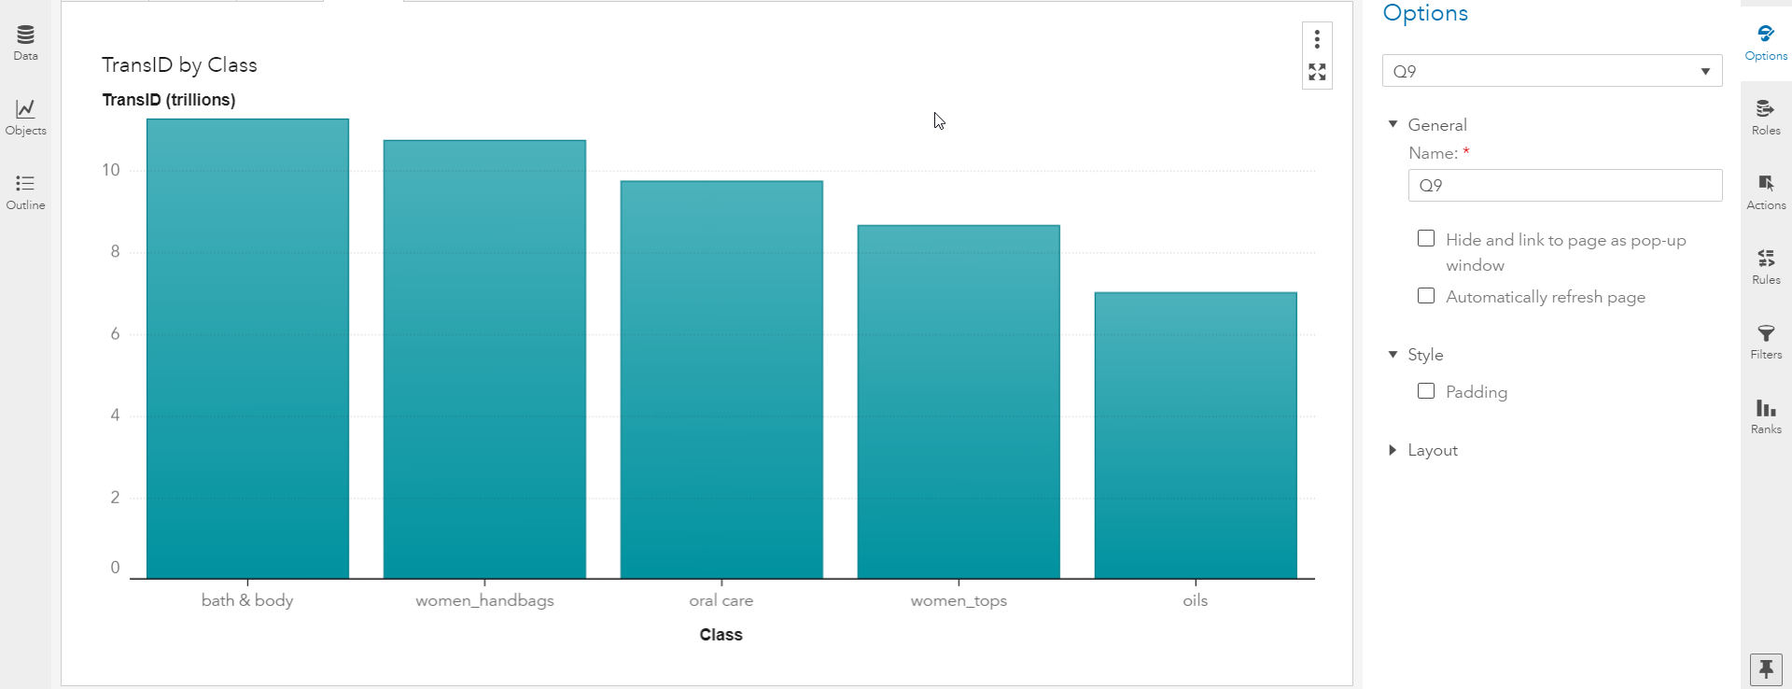
Insights
The plot shows the top 5 classes in terms of transaction.
Bath and body class have the highest number of transactions.

Slide 5
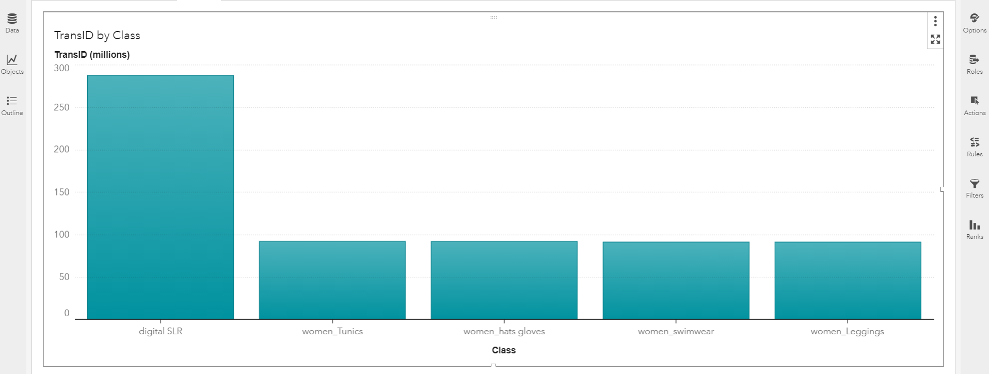
Insights
The plot shows the bottom 5 classes in terms of transaction.
Women leggings class have the minimum number of transactions.

Slide 6
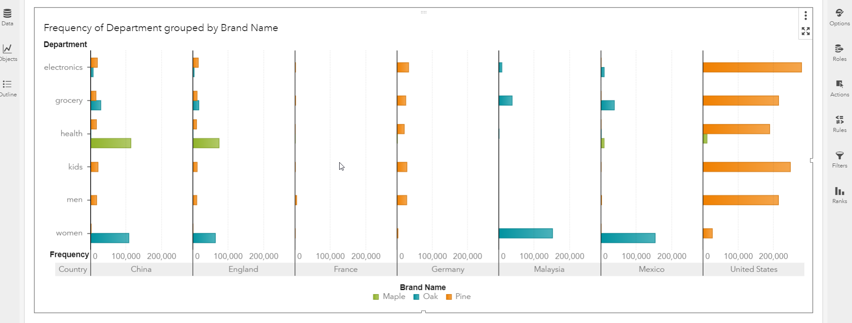
Insights
The bar plot shows popular brand with respect to frequency each department in different countries.
From the above plot, it is clear that Pine is the most popular brand in the countries.
Maple is least popular brand.

Slide 7
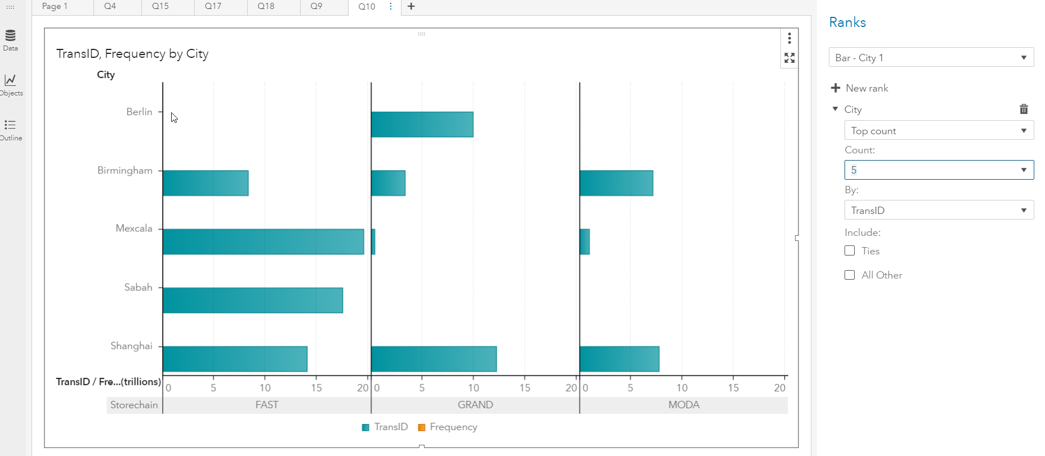
Insights
The plot shows the top 5 cities in terms of transaction.
Berlin city have the minimum number of transactions.
Mexcala had the highest number of transactions.

Slide 8
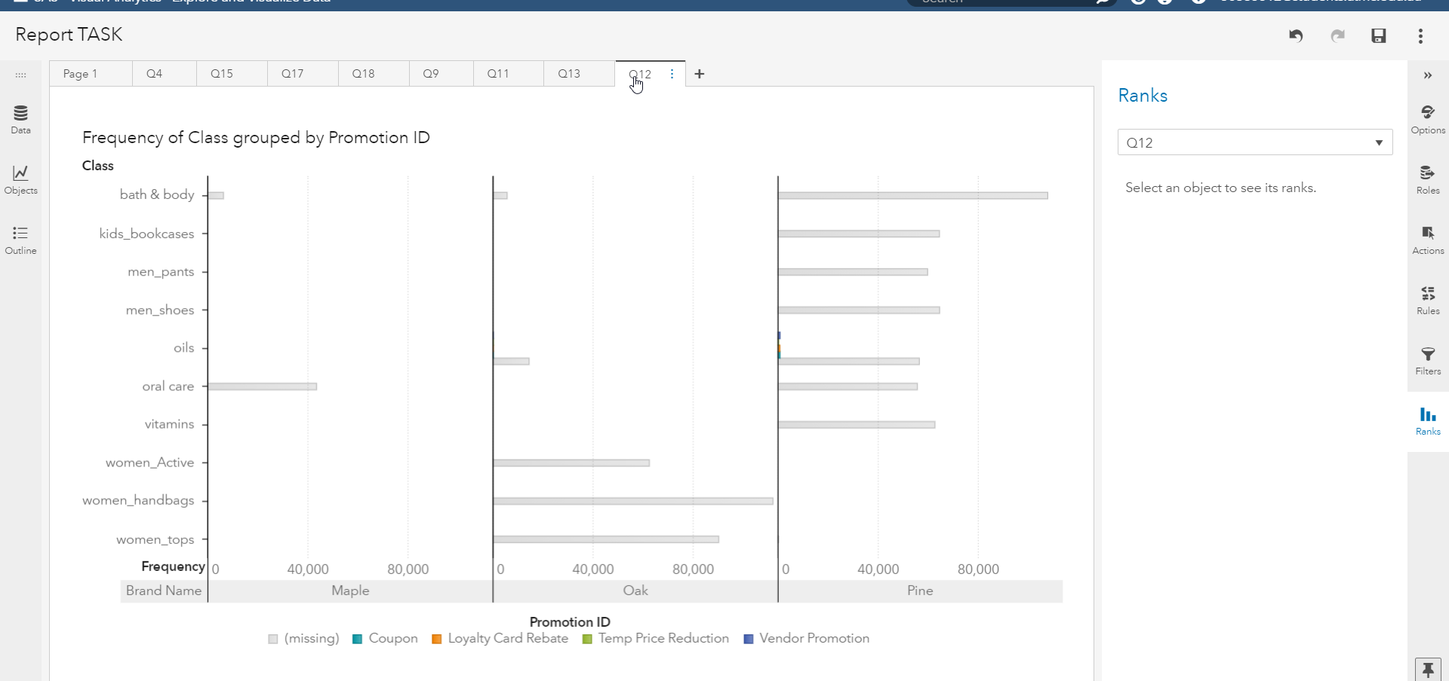
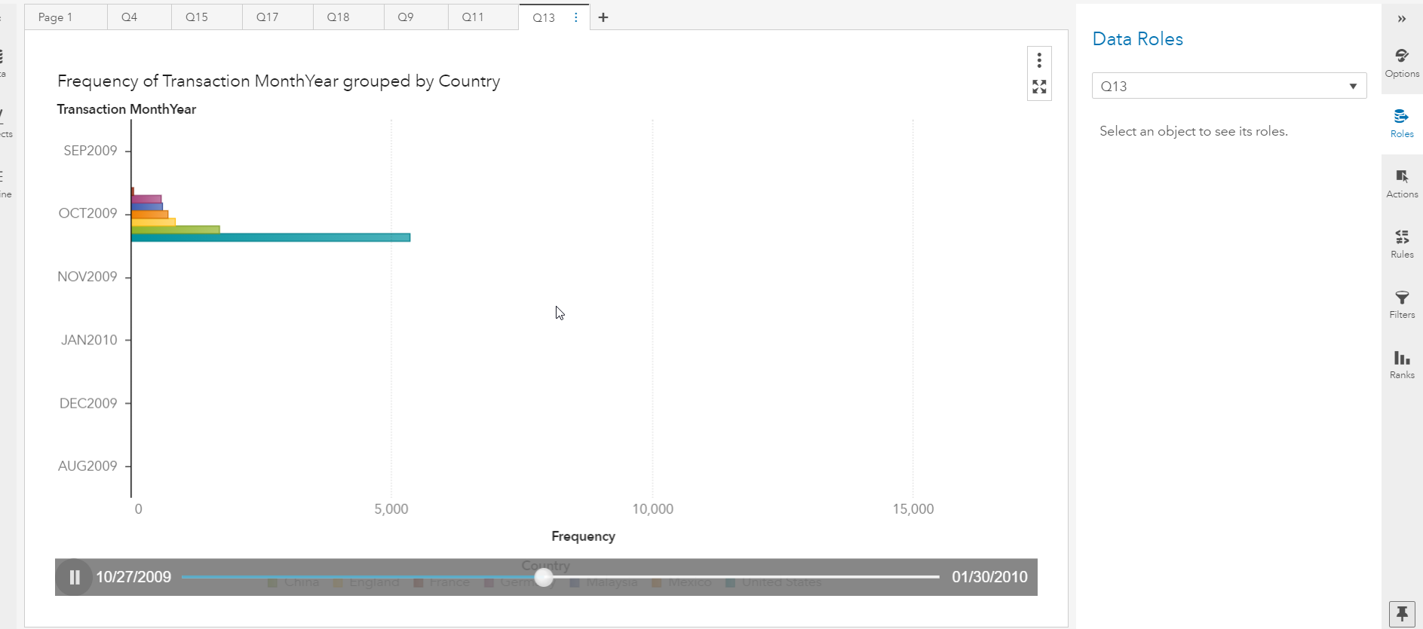
Insights
top 10 classes with respect to frequency for 4 different promotions are plotted as bar plot in the first plot given at the side.
For the trend of transactions across months for all countries are plotted below and depicted using animation.

